Slide 1
FinTech 545 Homework 1
Leslie Dees

Slide 2
Problem 1: Bias of Skewness & Kurtosis
Standard Normal Distribution
Skewness = 0
Kurtosis = 3
Using scipy.stats.moment method
Testing on 5000 sample distributions
Each sample distribution using 5000 points

Slide 3
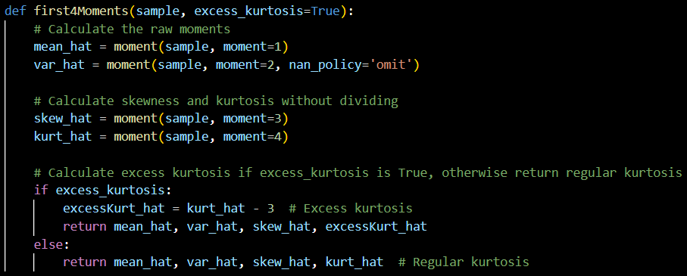
Problem 1: Bias of Skewness & Kurtosis

Slide 4
Problem 1: Bias of Skewness & Kurtosis
Results:
Known Kurtosis = 3
Average Estimated Kurtosis = 3.0010035
P-value = 0.6122
Known Skew = 0
Average Estimated Skew = -0.00032
P-value = 0.504425
Based on both p-values > 0.05, I cannot reject the null hypothesis that the results from the function are unbiased

Slide 5
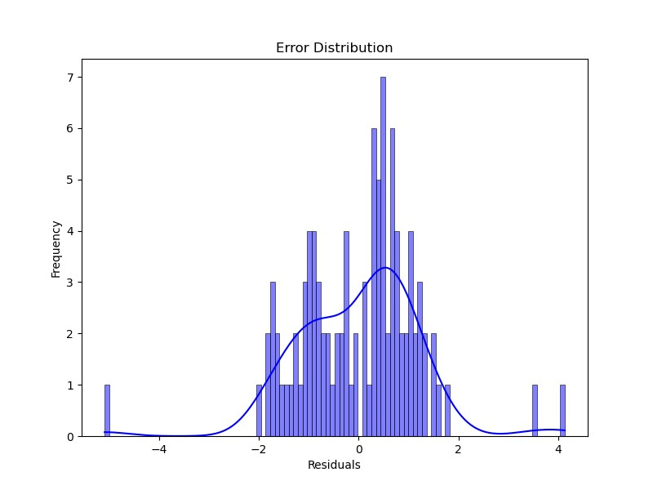
Problem 2: Fit Using OLS
Error vector obtained through statsmodels.api.sm.OLS
OLS.resid = error vector
Did NOT calculate the Beta values independently
Could potentially obtain them through OLS.params
Averaged Error Vector = -4.77e-17
Variance of Error Vector = 1.436
~Normal mean with > normal variance

Slide 6
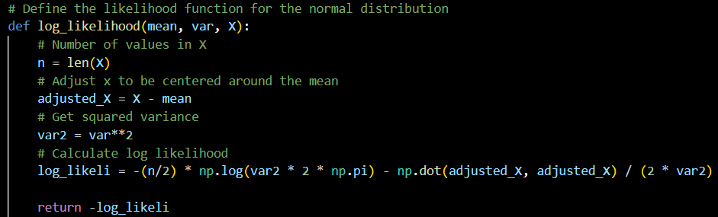

Problem 2: Fit MLE with Normality Assumption

Slide 7

Problem 2: Fit MLE with Normality Assumption
Process:
Initialize guesses for mean and std_dev to the mean and std_dev of y directly
Minimize the log likelihood between the predicted parameters I am using and the initial parameters
Issues:
Dot product between 2 adjusted x values rather than summing the square differences between x_i and mu
Minimizing the log likelihood directly is INCORRECT
I should have minimized the error term!

Slide 8
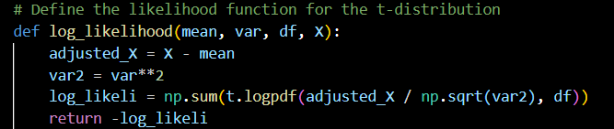
Problem 2: Fit MLE with t-distribution Assumption
Similar approach to the normal assumption, also initialize degrees of freedom to N-1 (N = length of X)
Minimizing log likelihood directly
Issues:
Error term not calculated from beta values in my code
Still not minimizing the error term

Slide 9
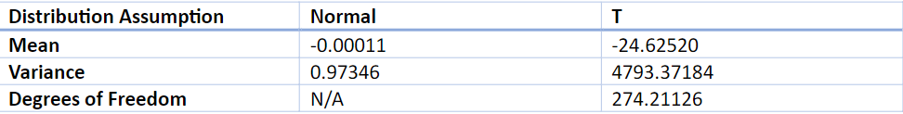
Problem 2: Parameters
I incorrectly obtained only the mean, standard deviation, and degrees of freedom (for t-distribution)
Did not produce values for Beta ☹
Normality assumption did produce results that were statistically significant with a normal distribution that were “more significant” than the t-distribution results

Slide 10
Problem 2: Mistakes I should have considered
Computing the p-value for 2 separate hypothesis tests is NOT a valid metric for comparison
Rather, using the AIC and BIC should have been adequate to determine which distribution was a better fit of assumption for the MLE
Minimization needs to be performed on the error term, not on a mean and predicted values

Slide 11
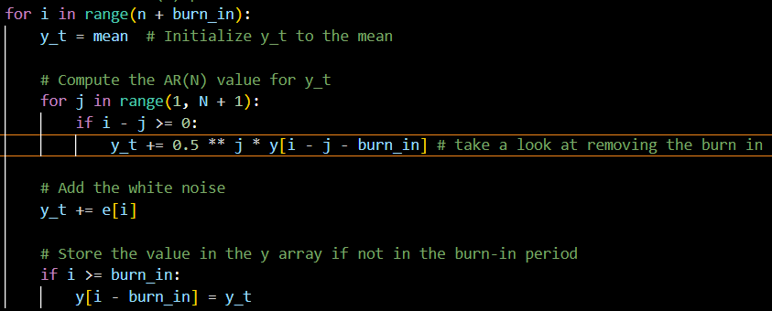

Problem 3: AR Simulation
Outer loop: Perform AR across all time steps n+burn_in
Inner loop: Perform predictions on y_t across entire period, only record values after burn-in period
Set Beta = 0.5 constant value for simple prediction

Slide 12
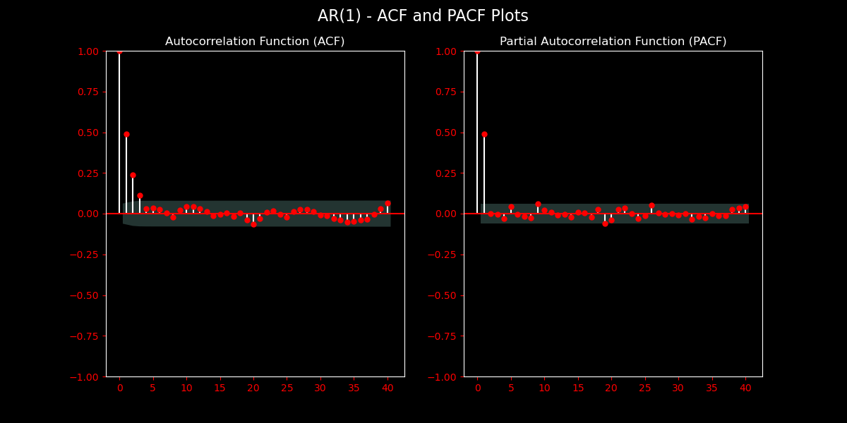
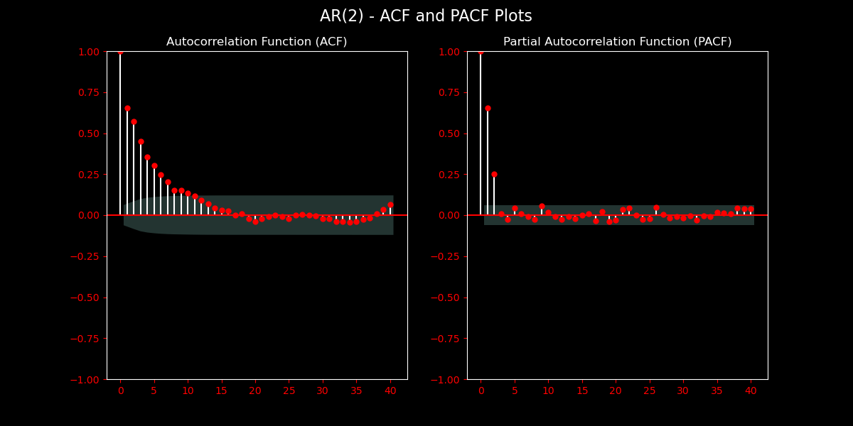
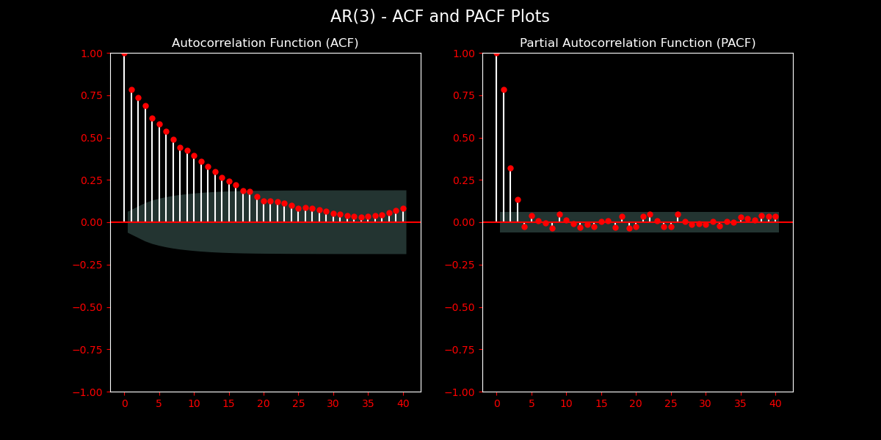
Problem 3: AR Simulation
The graphs help to determine the order based on the spikes in the PACF graphs
First item in PACF is lag of 0, which is perfectly correlated with itself and therefore has a value of 1.0
Items progress and oscillate around 0 in PACF
ACF shows an exponentially decreasing relationship as N increases

Slide 13
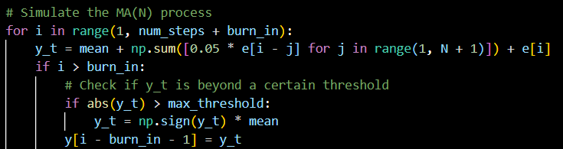

Problem 3: MA Simulation
Outer loop: Perform MA across all time steps n+burn_in
Inner loop: Perform predictions on y_t across entire period, only record values after burn-in period
Set Theta = 0.05 constant value for simple prediction
Maximized a threshold for y_t due to problems explained in several slides

Slide 14
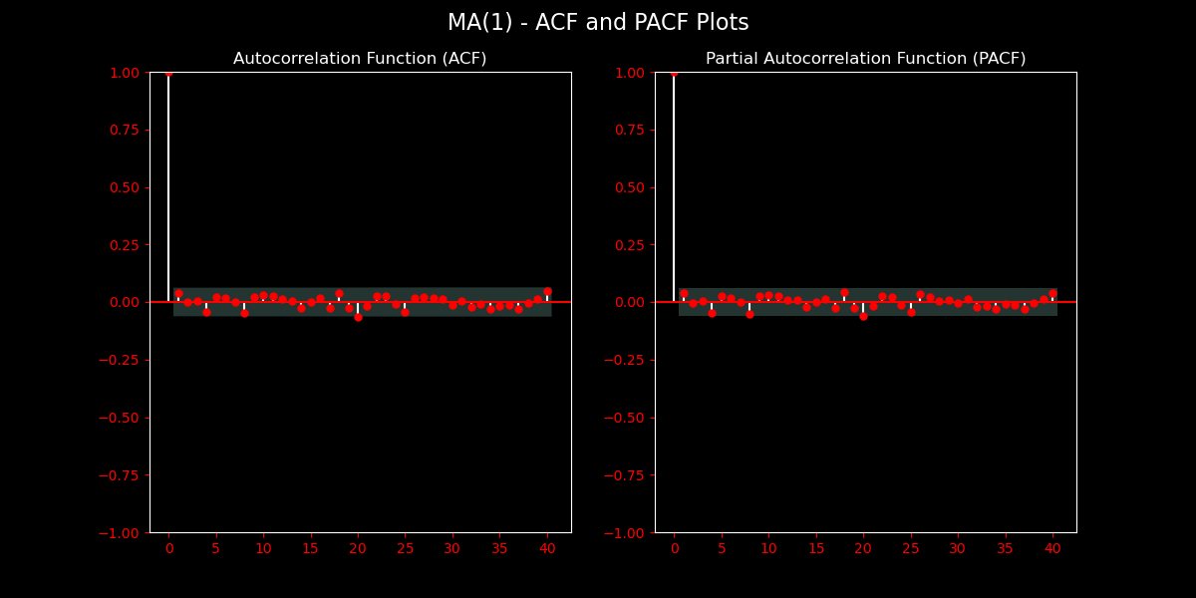
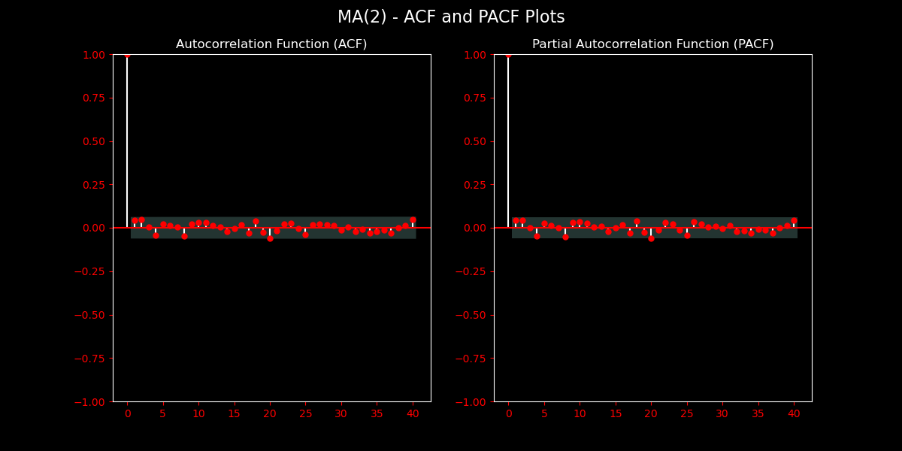
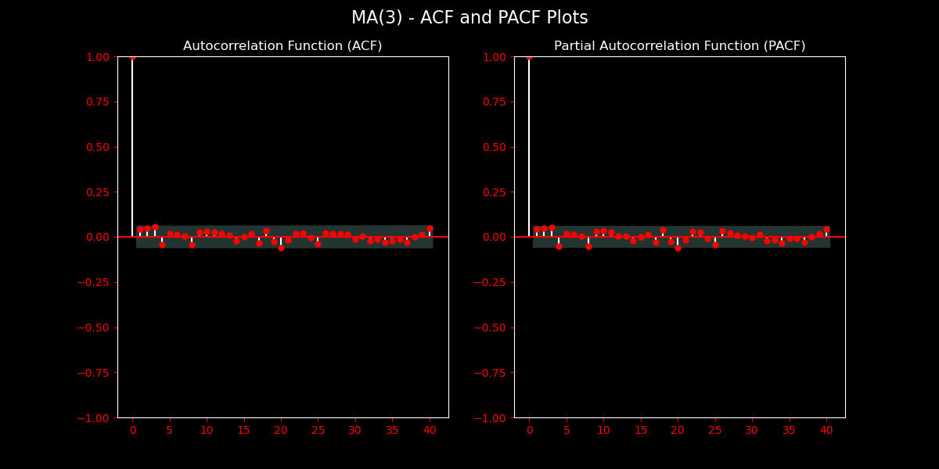
Problem 3: MA Simulation
MA graphs are inconclusive in results
I observed a perfect correlation for lag 0 as expected, but 0 correlations for all lags > 0
Issue potentially with the calculation method in my code
Relation to value chosen for theta?
Relation to method of summation of error terms?
Should be a gradual tapering to 0 for PACF of MA
ACF should show an immediate drop after the Nth lag, where the MA(N) process is depicted

Slide 15
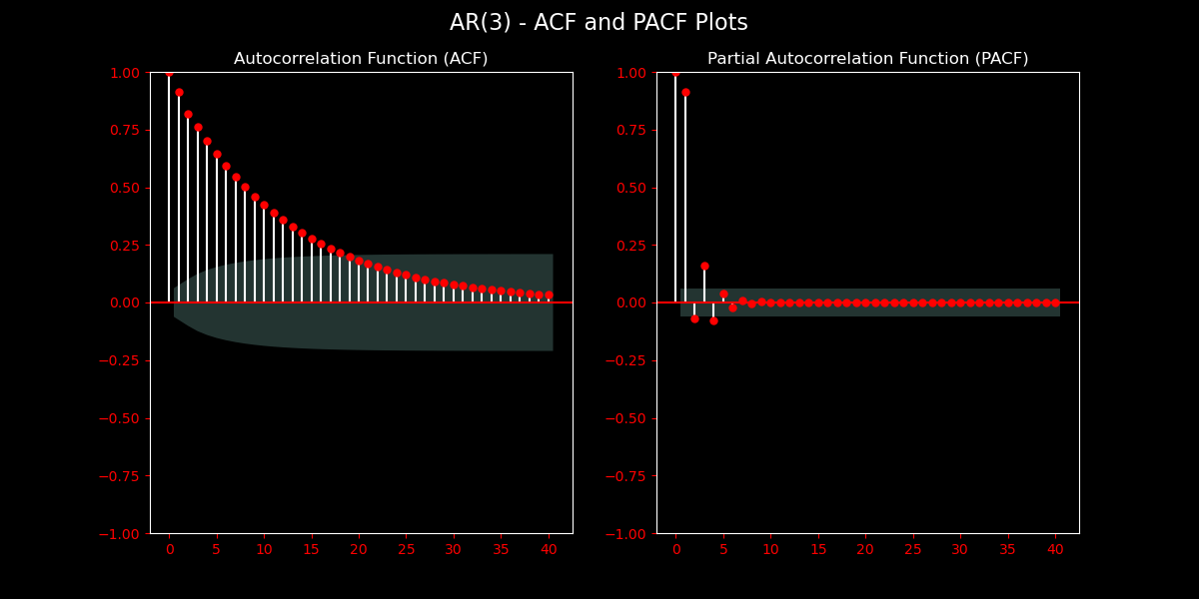
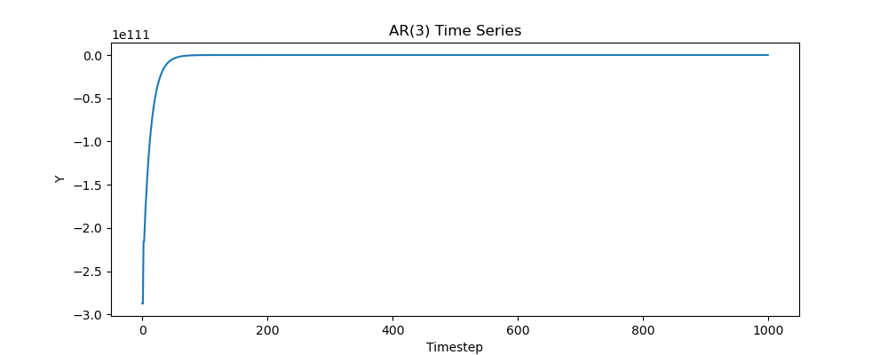
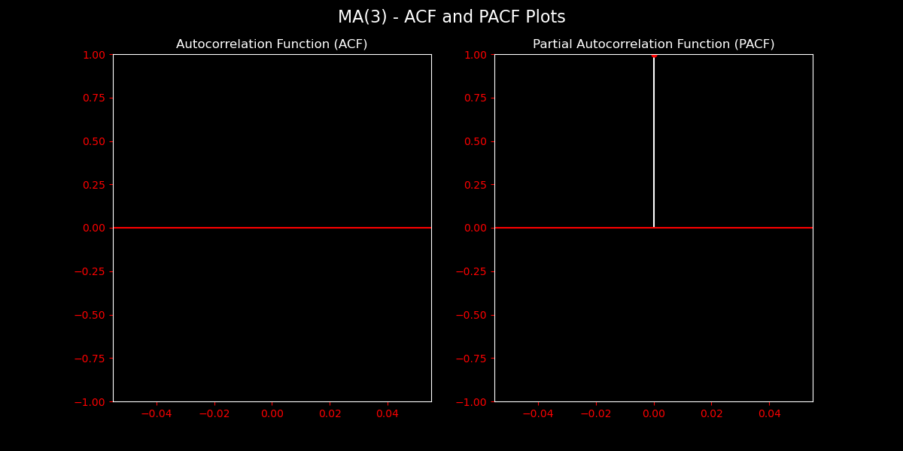
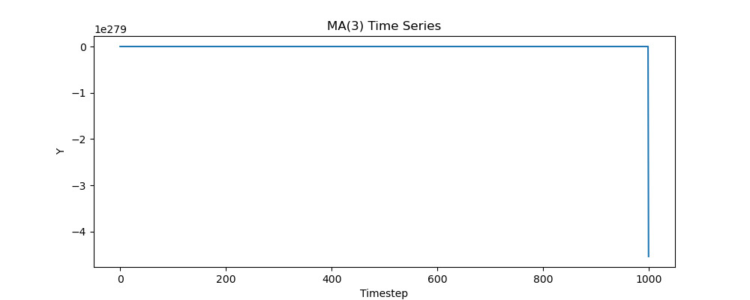
Problem 3: Totality and Issues
Plotting function randomly sets initial term of AR and final term of MA to infinity – Still unresolved

